Slide 1
TCSS 342 Lecture Notes
Graphs
Suggested reading from Weiss book:
Ch. 14
These lecture notes are copyright (C) Marty Stepp, 2006. They may not be rehosted, sold, or modified without expressed permission from the author. All rights reserved.

Slide 2
Lecture outline
graph concepts
  vertices, edges, paths
  directed/undirected
  weighting of edges
  cycles and loops
searching for paths within a graph
  depth-first search
  breadth-first search
  Dijkstra's algorithm
implementing graphs
  using adjacency lists
  using an adjacency matrix

Slide 3
Graph concepts

Slide 4
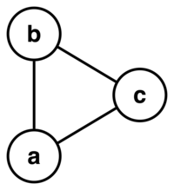
Graphs
graph: a data structure containing
  a set of vertices V
  a set of edges E, where an edge
  represents a connection between 2 vertices
the graph at right:
  V = {a, b, c}
  E = {(a, b), (b, c), (c, a)}
  Assuming that a graph can only have one edge between a pair of vertices, what is the maximum number of edges a graph can contain, relative to the size of the vertex set V?

Slide 5
More terminology
degree: number of edges touching a vertex
  example: W has degree 4
  what is the degree of X? of Z?
adjacent vertices: connected
directly by an edge
V
a
b
h
j
U
d
X
Z
c
e
i
W
g
f
Y

Slide 6
Paths
path: a path from vertex A to B is a sequence of edges that can be followed starting from A to reach B
  can be represented as vertices visited or edges taken
  example: path from V to Z: {b, h} or {V, X, Z}
reachability: V1 is reachable
from V2 if a path exists
from V1 to V2
connected graph: one in
which it's possible to reach
any node from any other
  is this graph connected?
V
a
b
P₁
d
U
X
Z
P₂
h
c
e
W
g
f
Y

Slide 7
Cycles
cycle: path from one node back to itself
  example: {b, g, f, c, a} or {V, X, Y, W, U, V}
loop: edge directly from node to itself
  many graphs don't allow loops
V
a
b
d
U
X
Z
C₂
h
e
C₁
c
W
g
f
Y

Slide 8
Weighted graphs
weight: (optional) cost associated with a given edge
example: graph of airline flights
  vertices: cities (airports) to which the airline flies
  edges: distance between airports in miles
  if we were programming this graph, what information would we have to store for each vertex / edge?
849
PVD
1843
ORD
142
SFO
802
LGA
337
1743
1387
HNL
2555
1099
LAX
1233
DFW
1120
MIA

Slide 9
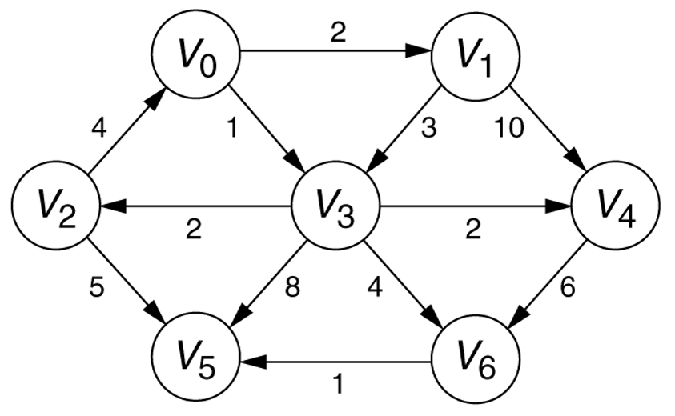
Directed graphs
directed graph (digraph): edges are one-way connections between vertices
  if graph is directed, a vertex has a separate in/out degree

Slide 10
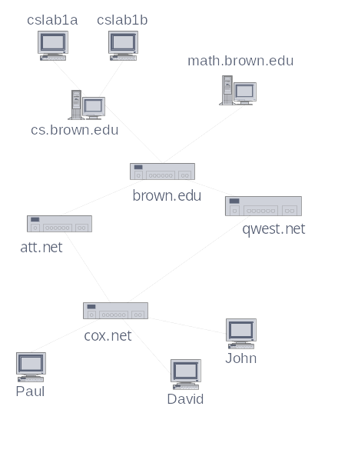
Graph questions
Are the following graphs directed or not directed?
  Buddy graphs of instant messaging programs?
  (vertices = users, edges = user being on another's buddy list)
  bus line graph depicting all of Seattle's bus stations and routes
  graph of the main backbone servers
  on the internet
  graph of movies in which actors
  have appeared together
Are these graphs potentially cyclic?
Why or why not?

Slide 11
Graph exercise
Consider a graph of instant messenger buddies.
  What do the vertices represent? What does an edge represent?
  Is this graph directed or undirected? Weighted or unweighted?
  What does a vertex's degree mean? In degree? Out degree?
  Can the graph contain loops? cycles?
Consider this graph data:
  Marty's buddy list: Mike, Sarah, Amanda.
  Mike's buddy list: Sarah, Emily.
  David's buddy list: Emily, Mike.
  Amanda's buddy list: Emily, Mike.
  Sarah's buddy list: Amanda, Marty.
  Emily's buddy list: Mike.
  Compute the in/out degree of each vertex. Is the graph connected?
  Who is the most popular? Least? Who is the most antisocial?
  If we're having a party and want to distribute the message the most quickly, who should we tell first?

Slide 12
Basic graph searching

Slide 13
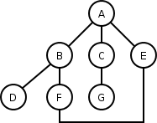
Depth-first search
depth-first search (DFS): finds a path between two vertices by exploring each possible path as many steps as possible before backtracking
  often implemented recursively

Slide 14
DFS pseudocode
Pseudo-code for depth-first search:
dfs(v1, v2):
dfs(v1, v2, {})
dfs(v1, v2, path):
path += v1.
mark v1 as visited.
if v1 is v2:
path is found.
for each unvisited neighbor v_{i} of v1
where there is an edge from v1 to v_{i}:
if dfs(v_{i}, v2, path) finds a path, path is found.
path -= v1. path is not found.

Slide 15
DFS pseudocode
Pseudo-code for depth-first search: Recursive version
dfs(in v:Vertex)
// Traverses a graph beginning at vertex v by using a
// depth –first search: Recursive version.
Mark v as visited
for (each unvisited vertex u adjacent to v)
dfs(u)

Slide 16
DFS pseudocode
Pseudo-code for depth-first search: Iterative version
dfs(in v:Vertex)
// Traverses a graph beginning at vertex v by using a
// depth –first search: Iterative version.
s.createStack()
// push v onto the stack and mark it
s.push(v)
Mark v as visited
// loop invariant: there is a path from vertex v at the
// bottom of the stack s to the vertex at the top of s

Slide 17
DFS pseudocode
while (!s.isEmpty()) {
if ( no visited vertices are adjacent to the vertex on
the top of the stack)
s.pop() // backtrack
else {
Select an unvisited vertex u adjacent to the
vertex on the top of the stack
s.push(u)
Mark u as visited
} // end if
} // end while

Slide 18
DFS example
Paths tried from A to others (assumes ABC edge order)
  A
  A -> B
  A -> B -> D
  A -> B -> F
  A -> B -> F -> E
  A -> C
  A -> C -> G
  A -> E
  A -> E -> F
  A -> E -> F -> B
  A -> E -> F -> B -> D
What paths would DFS return from D to each vertex?

Slide 19
DFS example
Paths tried from A to others (assumes ABC edge order)
Node visited Stack (bottom to top)
A A
B A B
D A B D
(backtrack) A B
F A B F
E A B F E
(backtrack) A B F
(backtrack) A B
(backtrack) A
C A C

Slide 20
DFS example
Node visited Stack (bottom to top)
G A C G
(backtrack) A C
(backtrack) A
E A E
F A E F
B A E F B
D A E F B D

Slide 21
DFS observations
guaranteed to find a path if one exists
easy to retrieve exactly what the path
is (to remember the sequence of edges
taken) if we find it
optimality: not optimal. DFS is guaranteed to find a path, not necessarily the best/shortest path
  Example: DFS(A, E) may return
  A -> B -> F -> E

Slide 22

DFS example
Using DFS, find a path from BOS to SFO.
BOS
ORD
v
4
JFK
v
2
v
6
SFO
DFW
LAX
v
v
3
1
MIA
v
5

Slide 23
Breadth-first search
breadth-first search (BFS): finds a path between two nodes by taking one step down all paths and then immediately backtracking
  often implemented by maintaining
  a list or queue of vertices to visit
  BFS always returns the path with
  the fewest edges between the start
  and the goal vertices

Slide 24
BFS pseudocode
Pseudo-code for breadth-first search:
bfs(v1, v2):
List := {v1}.
mark v1 as visited.
while List not empty:
v := List.removeFirst().
if v is v2:
path is found.
for each unvisited neighbor v_{i} of v
where there is an edge from v to v_{i}:
List.addLast(v_{i}).
path is not found.

Slide 25
BFS pseudocode
Pseudo-code for breadth-first search: another version
bfs(in v:Vertex)
// Traverses a graph beginning at vertex v by using a
// breadth-first search: Iterative version.
q.createQueue()
// add v to queue and mark it
q.enqueue(v)
while(!q.isEmpty()) {
w = q.dequeue()

Slide 26
BFS pseudocode
// loop invariant: there is a path form vertex w to
// every vertex in the queue q
for (each unvisited vertex u adjacent to w) {
Mark u as visited
q.enqueue(u)
} // end for
} // end while

Slide 27
BFS example
Paths tried from A to others (assumes ABC edge order)
  A
  A -> B
  A -> C
  A -> E
  A -> B -> D
  A -> B -> F
  A -> C -> G
  A -> E -> F
  A -> B -> F -> E
  A -> E -> F -> B
  A -> E -> F -> B -> D
What paths would BFS return from D to each vertex?

Slide 28
BFS observations
optimality:
  in unweighted graphs, optimal. (fewest edges = best)
  In weighted graphs, not optimal.
  (path with fewest edges might not have the lowest weight)
disadvantage: harder to reconstruct what the actual path is once you find it
  conceptually, BFS is exploring many possible paths in parallel, so it's not easy to store a Path array/list in progress
observation: any particular vertex is only part of one partial path at a time
  We can keep track of the path by storing predecessors for each vertex (references to the previous vertex in that path)

Slide 29
BFS example
Using BFS, find a path from BOS to SFO.
BOS
ORD
v
4
JFK
v
2
v
6
SFO
DFW
LAX
v
v
3
1
MIA
v
5

Slide 30
DFS, BFS runtime
What is the expected runtime of DFS, in terms of the number of vertices V and the number of edges E ?
What is the expected runtime of BFS, in terms of the number of vertices V and the number of edges E ?
Answer: O(|V| + |E|)
  each algorithm must potentially visit every node and/or examine every edge once.
  why not O(|V| * |E|) ?
What is the space complexity of each algorithm?
Notes:
O(|V| + |E|)
Space: DFS O(1), BFS O(|V| + |E|)

Slide 31
Implementing graphs

Slide 32
Implementing a graph
If we wanted to program an actual data structure to represent a graph, what information would we need to store?
  for each vertex?
  for each edge?
What kinds of questions
would we want to be able to
answer quickly:
  about a vertex?
  about its edges / neighbors?
  about paths?
  about what edges exist in the graph?
We'll explore three common graph implementation strategies:
  edge list, adjacency list, adjacency matrix
2
1
3
7
4
6
5

Slide 33
Edge list
edge list: an unordered list of all edges in the graph
advantages
  easy to loop/iterate over all edges
disadvantages
  hard to tell if an edge
  exists from A to B
  hard to tell how many edges
  a vertex touches (its degree)
2
1
3
7
4
6
1
5
1
2
2
3
5
7
5
5
5
2
1
6
7
3
4
6
4
7
4

Slide 34
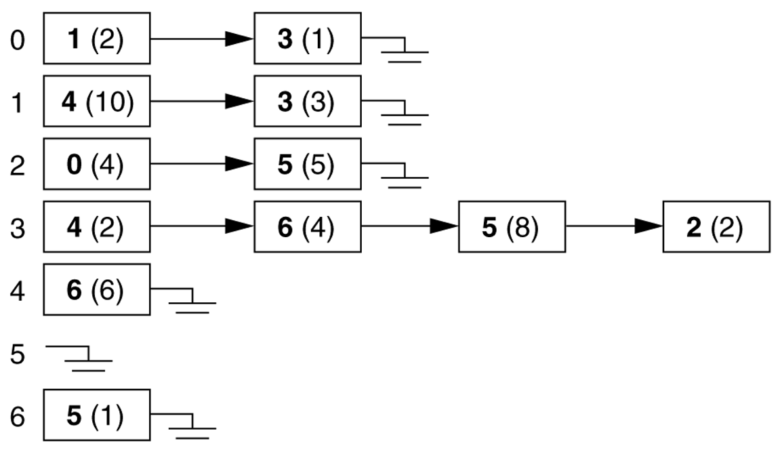
Adjacency lists
adjacency list: stores edges as individual linked lists of references to each vertex's neighbors
  generally, no information needs to be stored in the edges, only in nodes, these arrays can simply be pointers to other nodes and thus represent edges with little memory requirement

Slide 35
Pros/cons of adjacency list
advantage: new nodes can be added to the graph easily, and they can be connected with existing nodes simply by adding elements to the appropriate arrays
disadvantage: determining whether an edge exists between two nodes requires O(n) time, where n is the average number of incident edges per node

Slide 36
Adjacency list example
The graph at right has the following adjacency list:
  How do we figure out the degree of a given vertex?
  How do we find out whether an edge exists from A to B?
  How could we look for loops in the graph?
2
1
3
1
2
3
4
5
6
7
7
2
5
6
3
1
7
2
4
4
3
7
5
6
1
7
4
6
1
5
5
4
5
2

Slide 37
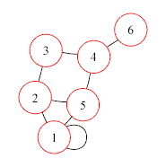
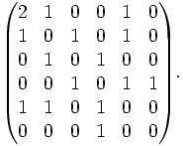
Adjacency matrix
adjacency matrix: an n × n matrix where:
  the nondiagonal entry a_{ij} is the number of edges joining vertex i and vertex j (or the weight of the edge joining vertex i and vertex j)
  the diagonal entry a_{ii} corresponds to the number of loops (self-connecting edges) at vertex i

Slide 38
Pros/cons of Adj. matrix
advantage: fast to tell whether edge exists between any two vertices i and j (and to get its weight)
disadvantage: consumes a lot of memory on sparse graphs (ones with few edges)

Slide 39
Adjacency matrix example
The graph at right has the following adjacency matrix:
  How do we figure out the degree of a given vertex?
  How do we find out whether an edge exists from A to B?
  How could we look for loops in the graph?
2
1
3
1 2 3 4 5 6 7
1
2
3
4
5
6
7
7
0
1
0
0
1
1
0
1
0
1
0
0
0
1
4
0
1
0
1
0
0
0
0
0
1
0
1
0
1
6
1
0
0
1
0
1
1
5
1
0
0
0
1
0
0
0
1
0
1
1
0
0

Slide 40
Runtime table
n vertices, m edges no parallel edges no self-loops | Edge List | Adjacency List | Adjacency Matrix
Space
Finding all adjacent vertices to v
Determining if v is adjacent to w
inserting a vertex
inserting an edge
removing vertex v
removing an edge
n vertices, m edges no parallel edges no self-loops | Edge List | Adjacency List | Adjacency Matrix
Space | n + m | n + m | n²
Finding all adjacent vertices to v | m | deg(v) | n
Determining if v is adjacent to w | m | min(deg(v), deg(w)) | 1
inserting a vertex | 1 | 1 | n²
inserting an edge | 1 | 1 | 1
removing vertex v | m | deg(v) | n²
removing an edge | 1 | deg(v) | 1

Slide 41
Practical implementation
Not all graphs have vertices/edges that are easily "numbered"
  how do we actually represent 'lists' or 'matrices' of vertex/edge relationships? How do we quickly look up the edges and/or vertices adjacent to a given vertex?
  Adjacency list: Map<V, List<V>>
  Adjacency matrix: Map<V, Map<V, E>>
  Adjacency matrix: Map<V*V, E>
849
PVD
1843
ORD
142
SFO
802
LGA
337
1743
1387
HNL
2555
1099
LAX
1233
DFW
1120
MIA
1
2
3
4
5
6
7
2
5
6
1 2 3 4 5 6 7
3
1
7
1
2
3
4
5
6
7
0
1
0
0
1
1
0
2
4
1
0
1
0
0
0
1
3
7
5
0
1
0
1
0
0
0
6
1
7
4
0
0
1
0
1
0
1
1
5
1
0
0
1
0
1
1
4
5
2
1
0
0
0
1
0
0
0
1
0
1
1
0
0

Slide 42
Maps and sets within graphs
since not all vertices can be numbered, we can use:
1. adjacency map
  each Vertex maps to a List of edges or adjacent Vertices
  Vertex --> List of Edges
  to get all edges adjacent to V1, look up
  List<Edge> v1neighbors = map.get(V1)
2. adjacency adjacency matrix map
  each Vertex maps to a Hash of adjacent
  Vertex --> (Vertex --> Edge)
  to find out whether there's an edge from V1 to V2, call map.get(V1).containsKey(V2)
  to get the edge from V1 to V2, call map.get(V1).get(V2)

Slide 43
Advanced graph searching

Slide 44
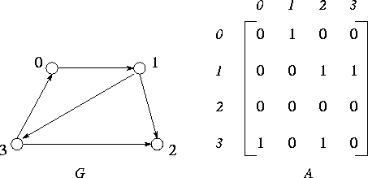
Floyd's algorithm
Floyd's algorithm: finds shortest (fewest edges) paths between all pairs of vertices in an unweighted, directed graph
  solves the "all pairs, shortest path" problem
  requires an adjacency matrix representation as its input
  outputs a matrix of path lengths
  key observation of Floyd's algorithm: transitivity
    if A can reach B in K steps, and C is adjacent to A, then C can reach B in K+1 steps.

Slide 45
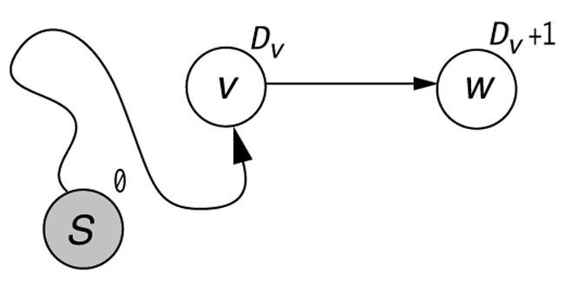
Reachability
if W is adjacent to V and there is a path from S to V, there must also be a path from S to W

Slide 46
Floyd's alg. pseudocode
D[i, i] = 0 for all i // construct initial path length matrix
D[i, j] = 1 for all i ≠ j with a direct edge from i to j
D[i, j] = ∞ otherwise
for (int k = 1 to N-1): // search for shortest paths
for (int i = 1 to N-1):
for (int j = 1 to N-1):
D[i, j] = min(D[i, j], D[i, k] + D[k, j])

Slide 47
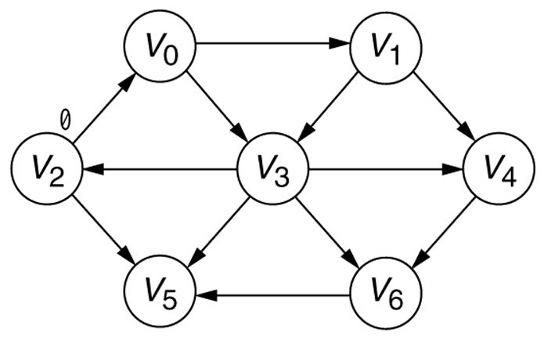
Floyd's alg., one perspective
the graph, after the starting vertex is marked as being reachable in 0 steps

Slide 48
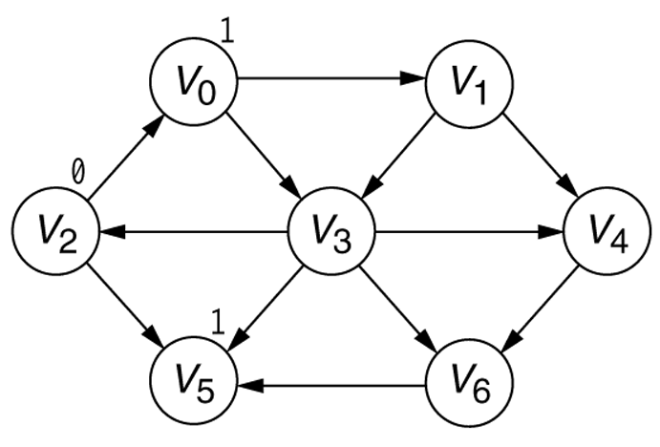
Floyd's alg., one perspective
the graph, after all paths of length 1 from the starting vertex have been found

Slide 49

Floyd's alg., one perspective
the graph, after all paths of length 2 from the starting vertex have been found

Slide 50
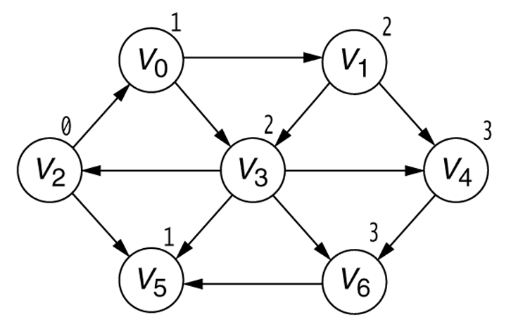
Floyd's alg., one perspective
final shortest paths

Slide 51
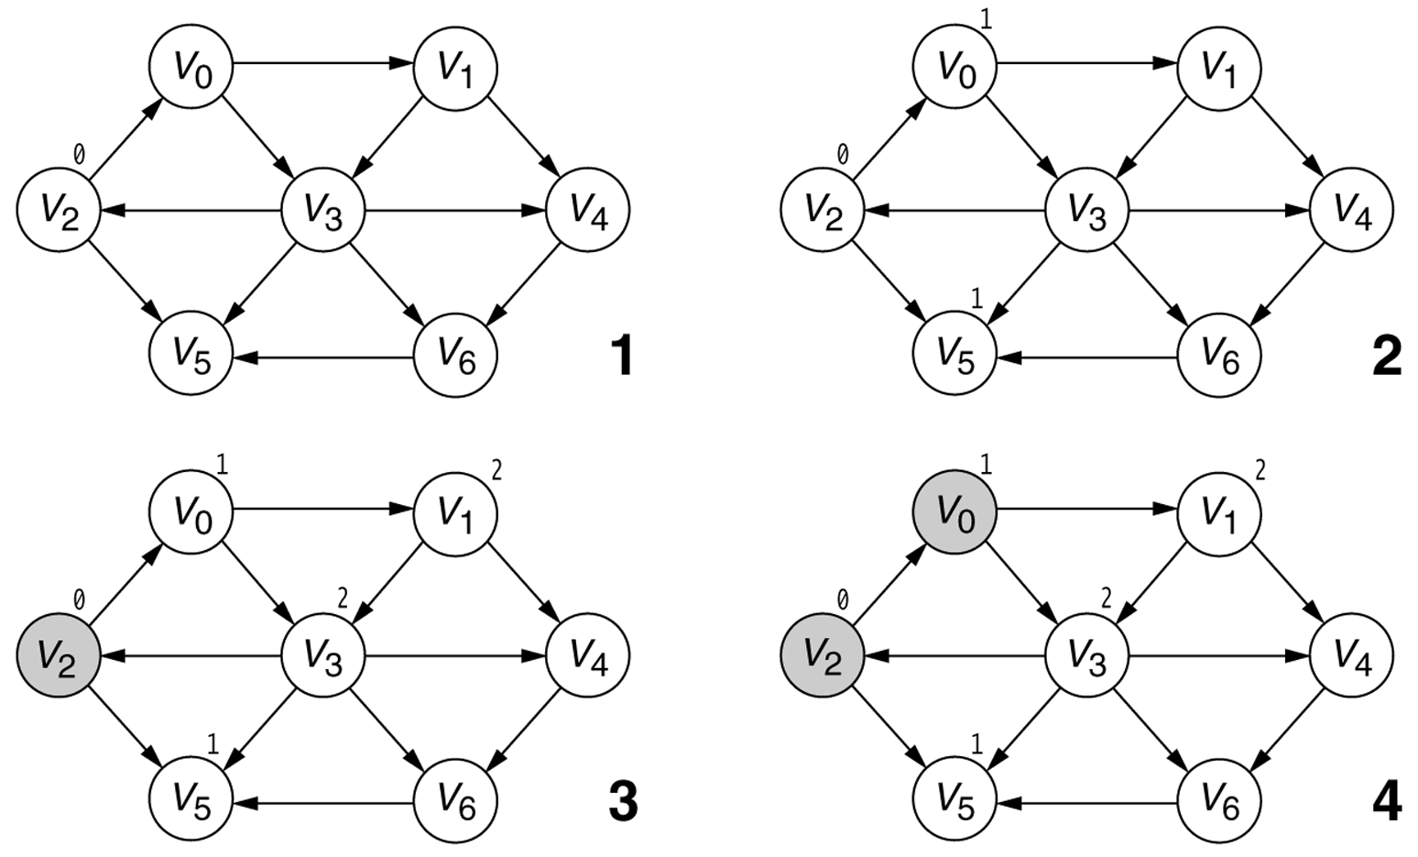
Floyd's alg., one perspective
Searching the graph in the unweighted shortest-path computation. The darkest-shaded vertices have already been completely processed, the lightest-shaded vertices have not yet been used as v, and the medium-shaded vertex is the current vertex, v. The stages proceed left to right, top to bottom, as numbered (continued).

Slide 52
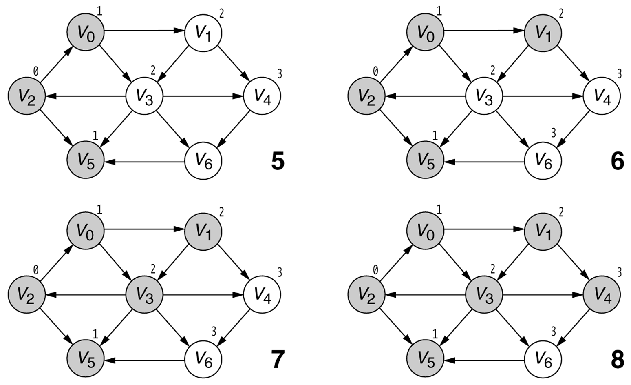
Floyd's alg., one perspective
Searching the graph in the unweighted shortest-path computation. The darkest-shaded vertices have already been completely processed, the lightest-shaded vertices have not yet been used as v, and the medium-shaded vertex is the current vertex, v. The stages proceed left to right, top to bottom, as numbered (continued).

Slide 53
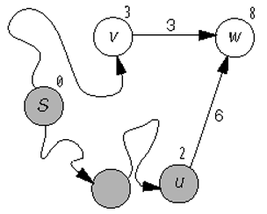
Improving paths
S currently can reach W with weight 8 (D[S, W] = 8)
  on the next pass of the algorithm:
  D[S, V] = 3
  D[V, W] = 3
  so D[S, W] is updated to be
  3 + 3 = 6

Slide 54
Dijkstra's algorithm
Dijkstra's algorithm: finds shortest (minimum weight) path between a particular pair of vertices in a weighted directed graph with nonnegative edge weights
  solves the "one vertex, shortest path" problem
  basic algorithm concept: create an NxN matrix of
  (distance, previous vertex) and improve it until it reaches the best solution
in a graph where:
  vertices represent cities,
  edge weights represent driving distances between pairs of cities connected by a direct road,
  Dijkstra's algorithm can be used to find the shortest route between one city and any other

Slide 55
Dijkstra pseudocode
Dijkstra(v1, v2):
for each vertex v: // Initialization
v's distance := infinity.
v's previous := none.
v1's distance := 0.
List := {all vertices}.
while List is not empty:
v := remove List vertex with minimum distance.
for each neighbor n of v:
dist := v's distance + edge (v, n)'s weight.
if dist is smaller than n's distance:
n's distance := dist.
n's previous := v.
reconstruct path from v2 back to v1,
following previous pointers.

Slide 56
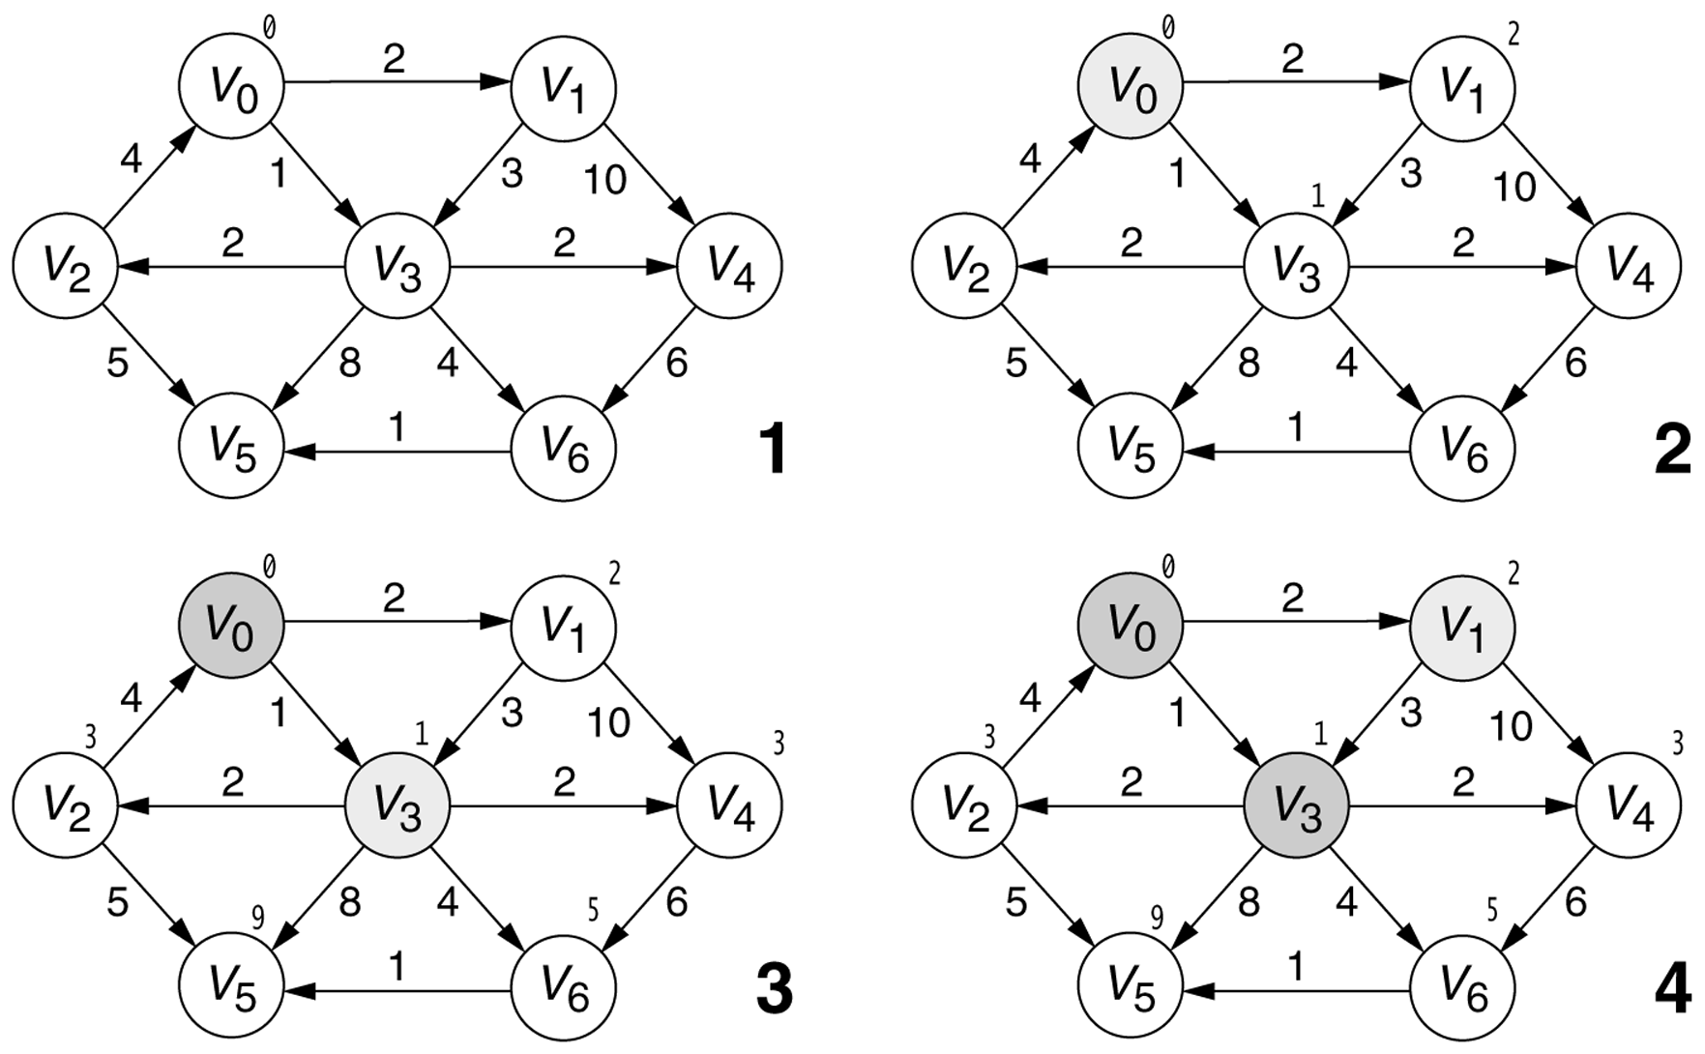
Stages of Dijkstra's algorithm

Slide 57
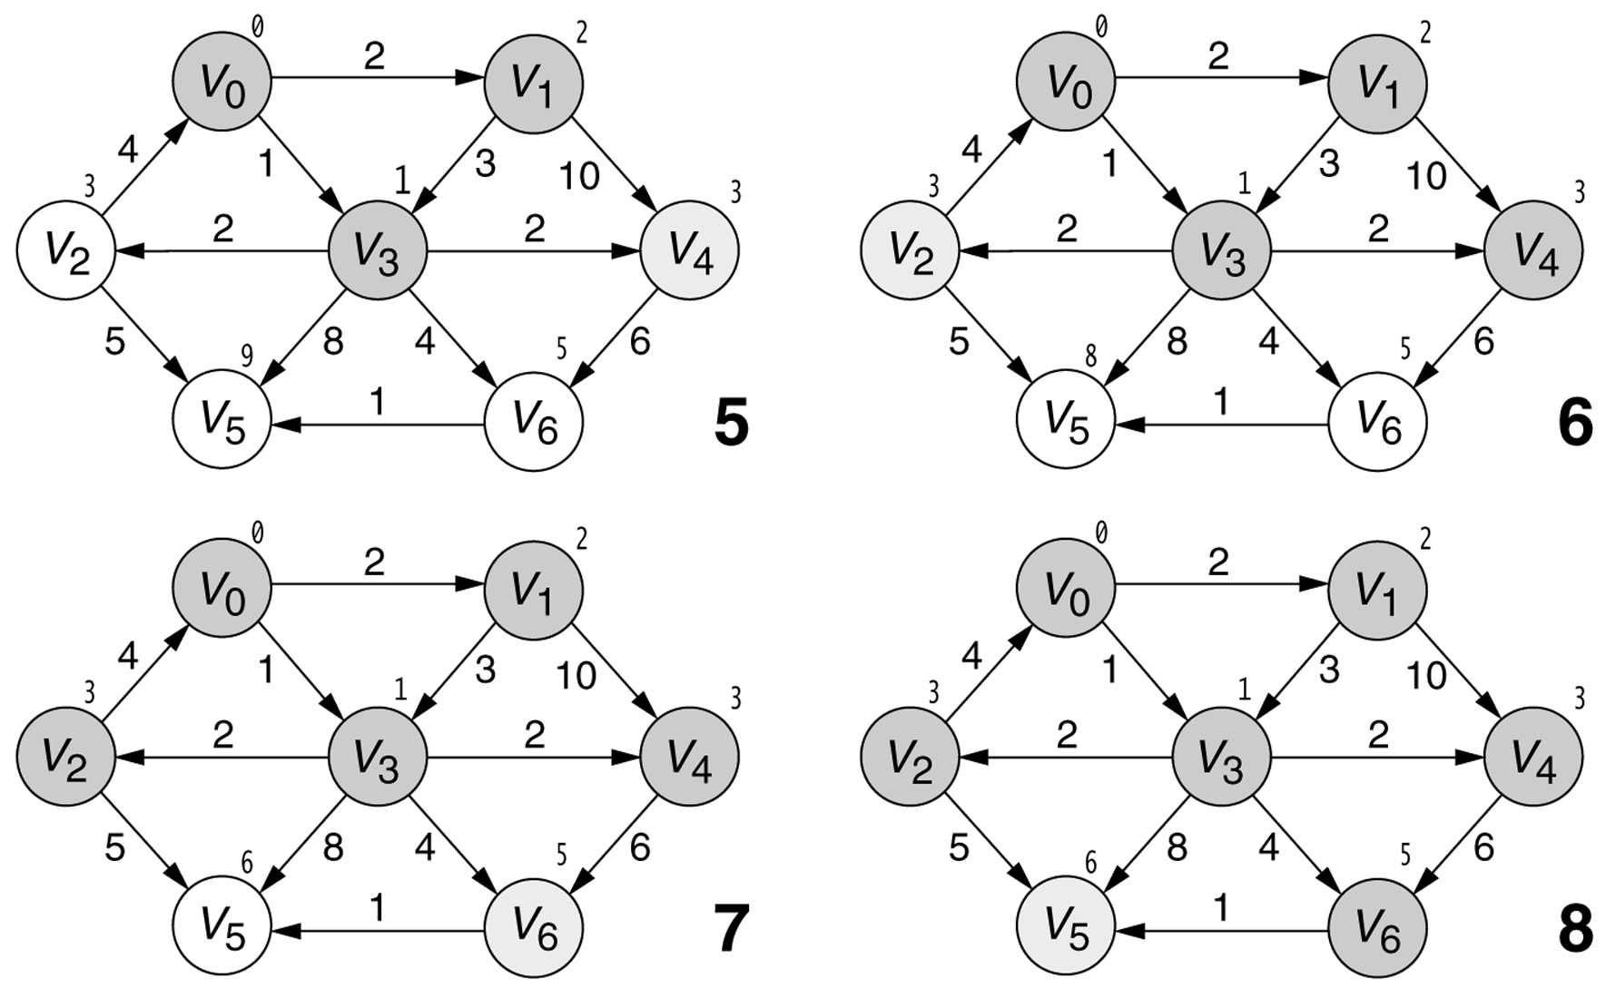
Stages of Dijkstra's algorithm

Slide 58
Runtime of Dijkstra's alg.
The simplest implementation of the Dijkstra's algorithm stores vertices of set Q in an ordinary linked list or array
  operation Extract-Min(Q) is simply a linear search through all vertices in Q
  in this case, the running time is O(V²)
For sparse graphs, that is, graphs with much less than V² edges:
  Dijkstra's algorithm can be implemented more efficiently by using a fast data structure named a priority queue to implement the removeMin function
  algorithm improves to O((E+V)logV) time

Slide 59
Other graph algorithms at a glance

Slide 60
Topological sort
topological sort for a directed acyclic graph ("DAG"):
a linear ordering of its nodes where x comes before y if there's a directed path from x to y in the DAG.
  in other words, each node comes before all nodes to which it has edges
  every DAG has >= 1 legal topological sort, and may have many
  like many graph algorithms, topological sort can be performed in O(|V| + |E|) time

Slide 61
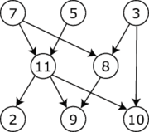
Topological sort example
Legal topological sorts for the graph shown:
  7,5,3,11,8,2,9,10
  7,5,11,2,3,10,8,9
  3,7,8,5,11,10,9,2

Slide 62
Topological sort pseudocode
Q := Set of all nodes with no incoming edges.
while graph has edges or Q is non-empty:
if Q is empty:
error. // (all remaining edges are part of a cycle)
remove a node n from Q.
output n.
for each node m with an edge from n to m:
remove that edge from the graph.
if m has no other incoming edges:
insert m into Q.

Slide 63
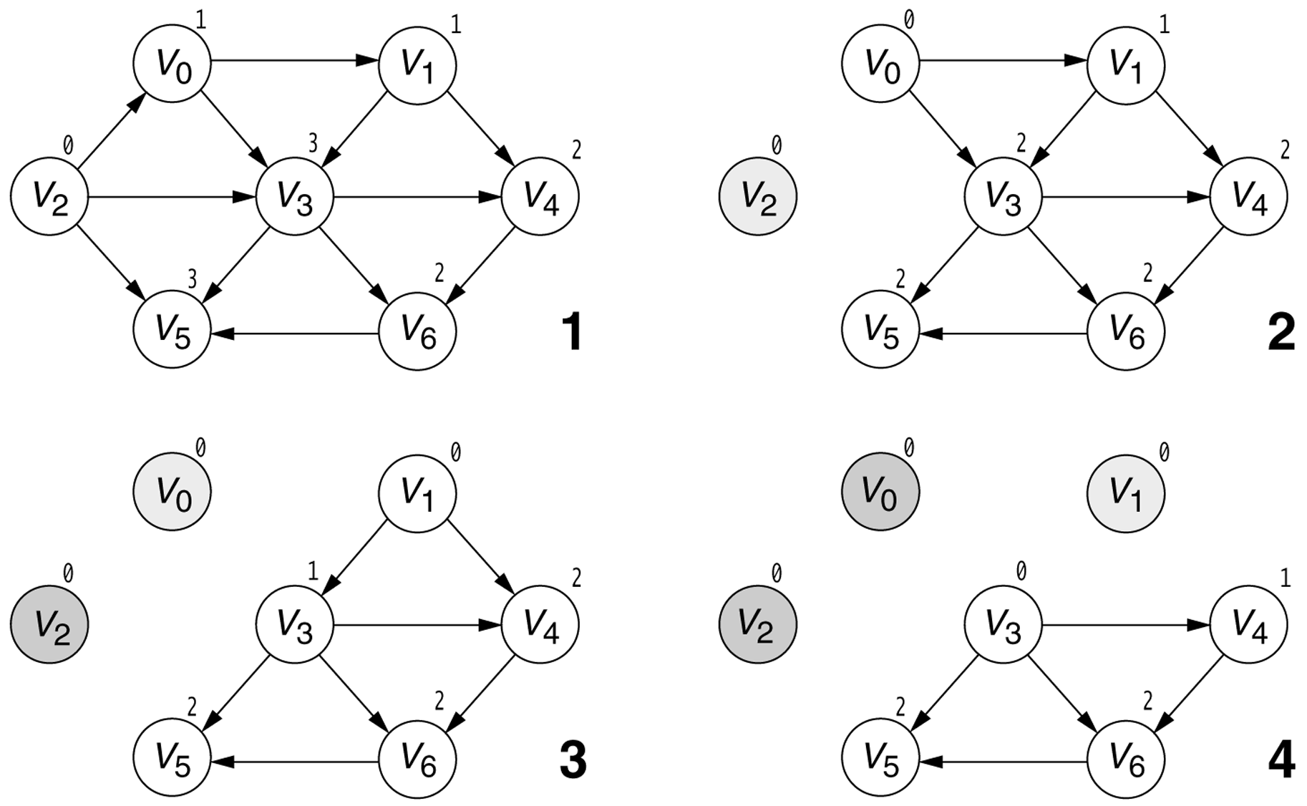
Topological sort example

Slide 64
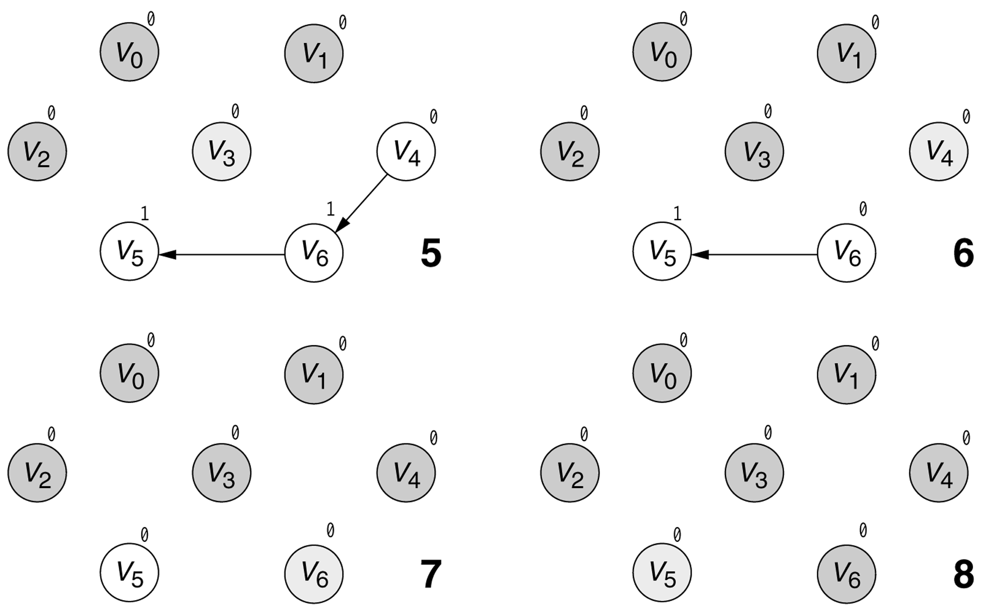
Topological sort example

Slide 65
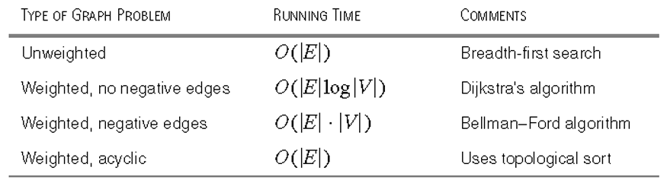
Worst-case running times

Slide 66
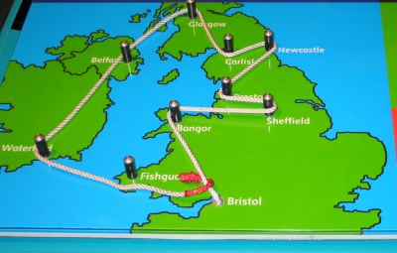
Traveling Salesman Problem
traveling salesman problem ("TSP"): task of finding the minimum-weight path in a weighted directed graph that touches every vertex
  such a path is called a Hamilton path
  TSP is known to be very difficult to solve efficiently
  it is called an NP-complete problem because it is unlikely that a computer can solve it without essentially trying every single possible path and comparing the results
  there are an exponential number of possible paths, so this algorithm takes exponential time for a computer to solve

Slide 67
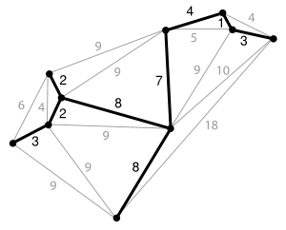
Minimum spanning tree
tree: a connected, directed acyclic graph
spanning tree: a subgraph of a graph, which meets the constraints to be a tree (connected, acyclic) and connects every vertex of the original graph
minimum spanning tree: a spanning tree with weight less than or equal to any other spanning tree for the given graph

Slide 68
Min. span. tree applications
Consider a cable TV company laying cable to a new neighborhood...
  If it is constrained to bury the cable only along certain paths, then there would be a graph representing which points are connected by those paths.
  Some of those paths might be more expensive, because they are longer, or require the cable to be buried deeper.
    These paths would be represented by edges with larger weights.
  A spanning tree for that graph would be a subset of those paths that has no cycles but still connects to every house.
    There might be several spanning trees possible. A minimum spanning tree would be one with the lowest total cost.

